Slide 1
Community School District 10
TOWN HALL MEETING
AUGUST 13, 2020
6:00 PM
Maribel Torres-Hulla
Community School Superintendent

Slide 2
Welcome Community School District Ten Families, Students and Community Leaders
THANK YOU for joining us
Our Town Hall Meeting will begin shortly

Slide 3
This Town Hall Meeting will be Co-hosted by Maria C. Correa, District Family Support Coordinator Elba I. Velez, District Family Leadership Coordinator
and
Supported by the Office of Family and Community Empowerment (FACE)
Anthony Thomas, Parent Empowerment Liaison
Jose Gonzalez, School-Based Parent Liaison
Lynn Sanchez, School-Based Parent Liaison
Mohamed Morshed, Parent Empowerment Liaison
Julianna Federoff, Parent Leadership Liaison

Slide 4
Meeting Norms
Please keep yourself on mute whenever you are not speaking.
This is a public meeting and will be recorded.
Spanish Interpretation is available. Please call this number 1-347-966-4114 & use Pin ID 821 096 54#.
If you want to hear the Spanish audio on the telephone but want to remain in the virtual Zoom conference room, please mute the volume on your computer/device.
Put comments & questions in the “chat” or Q&A section.
If you wish to speak, please press the “Hand” icon on the bottom of your screen.
Please note that there will be a Q&A Session at the end of the meeting.

Slide 5
MARIBEL TORRES-HULLA
COMMUNITY SCHOOL SUPERINTENDENT
DISTRICT TEN
Leading with the Heart, Mind and Soul

Slide 6
District Ten Team
Maribel Torres- Hulla, Community Superintendent
Fia Davis, Deputy Superintendent
Gina Mautschke-Mitchell, Deputy Superintendent
Carmen H. Mercado, Field Support Liaison
Elizabeth Iadavaia, Director of Continuous Improvement
Hope Stephens, Director of Continuous Improvement
Loushonda Mack, Director of Continuous Improvement
Sara Greeson-Mitchell, Teacher Development Evaluation Coach
Jacqueline Baker, Early Childhood Director
Elba I. Velez, District Family Leadership Coordinator
Maria C. Correa, District Family Support Coordinator
Sharon Berger, Executive Assistant to the Superintendent

Slide 7
Comparison of Remote and Blended Learning Experiences: School Year 2020-21
Remote/Blended Learning
Synchronous learning refers to a learning event in which a group of students are engaging in ... use of instant messaging or live chat, webinars and video conferencing allow for students and teachers to collaborate and learn in real time.
Asynchronous learning is a general term used to describe forms of education, instruction, and learning that do not occur in the same place or at the same time. The term is most commonly applied to various forms of digital and online learning in which students learn from instruction—such as prerecorded video lessons or game-based learning tasks that students complete on their own—that is not being delivered in person or in real time.

Slide 10
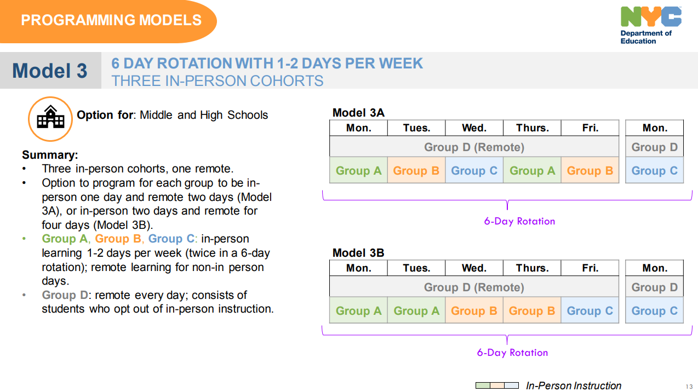

Slide 13
Instructional Guidance for the Fall 2020 -2021
Students must have equitable access to high-quality instruction and educational opportunity, expectations for high quality instruction rest upon the same essential elements of strong core instruction that are culturally responsive whether students are learning in an all remote or in a blended learning model. Instruction for all students must focus on these key elements: Begin with ”Know Students Well” Integrate academics and social emotional learning Ensure continuity of learning through a shared and inclusive curriculum Focus on priority learning

Slide 14
SCHOOL REOPENING QUESTIONS
Instruction
Will my child have the same teacher for remote and in person instruction? Will there be Saturday programs or afterschool? What will teaching look like for 100% remote learning? Will there be live teaching for remote students? What is the testing schedule for this year? What is the SEL curriculum? What are the accommodations for students with disabilities?​​ Including related services. Will the service be in-person or virtual? 7. How will enrichment classes like music, art and stem be taught ?
Notes:
Although actual student programming has not been completed yet, schools will try to the best of their abilities to keep students with the same teacher. However, there will be instances where this is not feasible.
It will be dependent on school budget.
Remote Learning will continue to be a blended model between synchronous and asynchronous teaching. Student will participate on the same curricula as in-person students.
ELA-> Tuesday, April 20-Thursday, April 22 Math-> Tuesday, May 4-Thursday, May 6 Regents-> Not available in the NYSED website.
These are guided by the student’s Individualized Educational Plan (IEP)
Special Education services will be provided as mandated by the IEP document. The services will be provided in-person or remotely as necessary and whenever possible.
Enrichment courses will be provided both on in-person and remotely. Social distance and student safety will be a priority.

Slide 15
SCHOOL REOPENING QUESTIONS
School Environment
Where will my child be eating? If I choose 100% remote will my child have access to meals? When will schools be meeting with parents to explain options or choices? How will social emotional issues be handled? Will parents be able to view the brick and mortar classroom set up? How will the issue of ill teachers be addressed? How will students be participating in gym? Will there be school holidays?

Slide 16
SCHOOL REOPENING QUESTIONS
Families
How can I sign up for childcare as per the Mayor? What other options will be provided for families that need school for the early childhood grades? What is going to happen to Rec centers? Can they still be considered an option for parents who need to work 5 days a week? Will iPads still be provided? What will happen to families without WiFi? Does the DOE have workshops for parents on how to use the platforms before the school year begins in September? Will there be Post Traumatic Stress Disorder (PTSD) support for families? How can parents change from blended learning to remote?

Slide 19
SCHOOL REOPENING QUESTIONS
Safety Concerns
How will sanitation be handled inside of school buildings including bathrooms and elevators? How will temperature checks be conducted? What will the procedure be for when a child or adult tests positive in a classroom? What are the requirements for returning to work when an adult or student tests positive? How will families be notified regarding possible exposure? How will bussing be handled? What is the protocol when a student gets injured and taken to the hospital? What plans have been put in place for contact tracing? Will parents be allowed into the school building?

Slide 20
Where are we now….
Next Steps
Parents complete Remote Learning Survey. Any parent who does not complete the survey will be placed into Blended Learning; however, survey will stay open so parents can request 100% remote learning
Week of August 10th - School Town Hall Meetings and School Leadership Team Collaborate on Model Choice
Reopening Plans Were submitted, Wednesday, August 12th
Model Choices Must be submitted by Friday, August 14th
Schedule next Townhall for Updates with CEC 10

